Slide 1
Same Product, Different Price: A Comparative Study of Retail Pricing Strategies
Michelle Cao & Liz Nguyen
May 5, 2025

Slide 2
AGENDA
Background & Motivation
Research Questions
Methods
Dataset overview
Models (Multi-LR, Decision trees)
Validation + Tuning
Our Findings
Implications to Stakeholders
Ethical, Legal, and Societal Concerns

Slide 3




Which is your go-to supermarket?

Slide 4
Background and motivations
Pricing transparency is increasingly important – nearly 70% of Americans report worry about grocery costs
Identical items cost about 20% more at one supermarket location than another just a few miles away
Consumer empowerment - knowledge of which stores offer better value helps them make informed decisions
Comparing prices reveals each retailer’s pricing strategy
Walmart’s basket of branded goods about 4% cheaper than Target’s (with certain categories like groceries 14% cheaper), reflecting Walmart’s Everyday Low Price (EDLP) strategy

Slide 5

Research question
How much do prices vary for the same product between different stores?
Are certain retailers consistently more expensive or cheaper?
Do pricing differences depend on product category or type?

Slide 6
Methods
Stores: Walmart, Target, Giants
Product Selection: ~1000 common grocery items per store
Location Control: Carlisle, PA (one fixed geographic location to ensure regional price comparability)
Data Fields Collected:
Product name, brand, size/quantity
Price at Walmart
Price at Target
Price at Giant
Fields added:
Calculated unit price per oz
Generate food group and product type categories

Slide 7
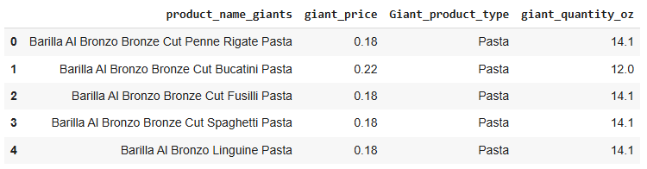
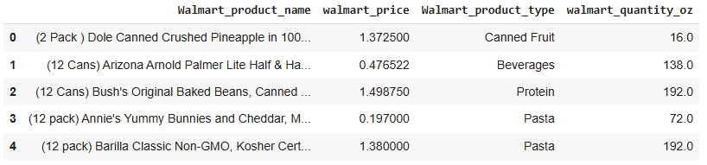
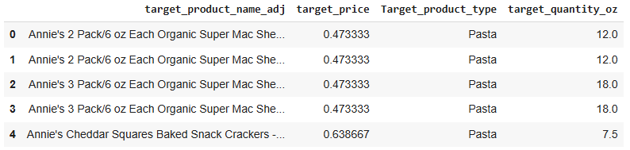
About the dataset

Slide 8
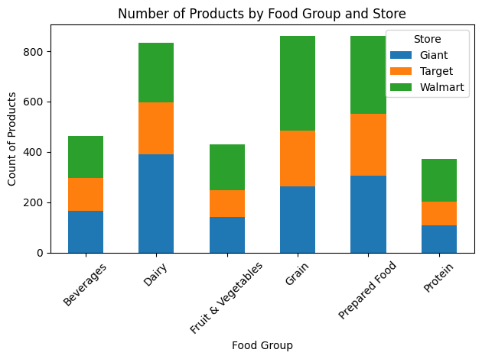
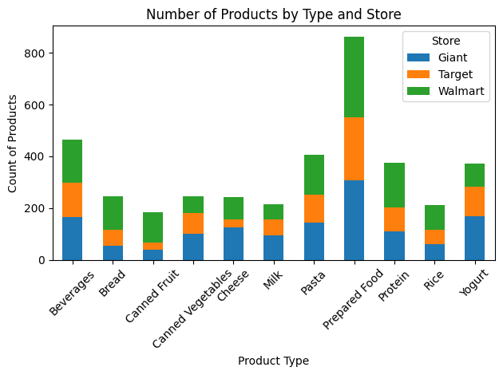
American consumers’ fast-paced lifestyles and preference for ready-to-eat or easily consumable products.
Giant: Focuses on broad selection to attract variety-seeking and possibly more health-conscious or time-constrained consumers.
Walmart: Likely targets price-sensitive shoppers with a more limited but essential inventory.
Target: Balances between selection and convenience, possibly geared toward urban, brand-aware consumers.

Slide 9
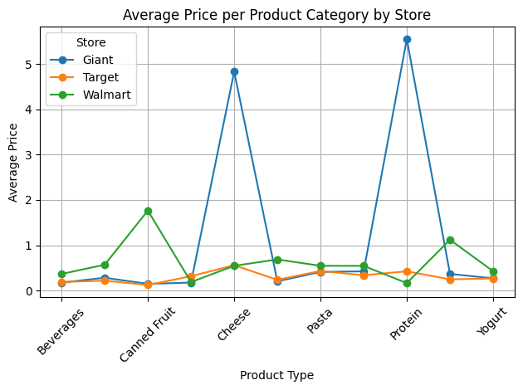
Smaller package sizes: Target often sells smaller units, resulting in lower per-item or per-unit prices.
Walmart’s online variance: Some Walmart listings may reflect third-party sellers or higher-priced bulk items.
Walmart prices often end in ".97" or ".88" (psychological pricing), but in rare cases, rounding or formatting issues can misrepresent them as higher.
Wider product variety: Giant offers more options per category, including premium and specialty items, raising average prices.
In-store shopping experience: Giant may target convenience-driven shoppers willing to pay more for location or customer service.

Slide 10
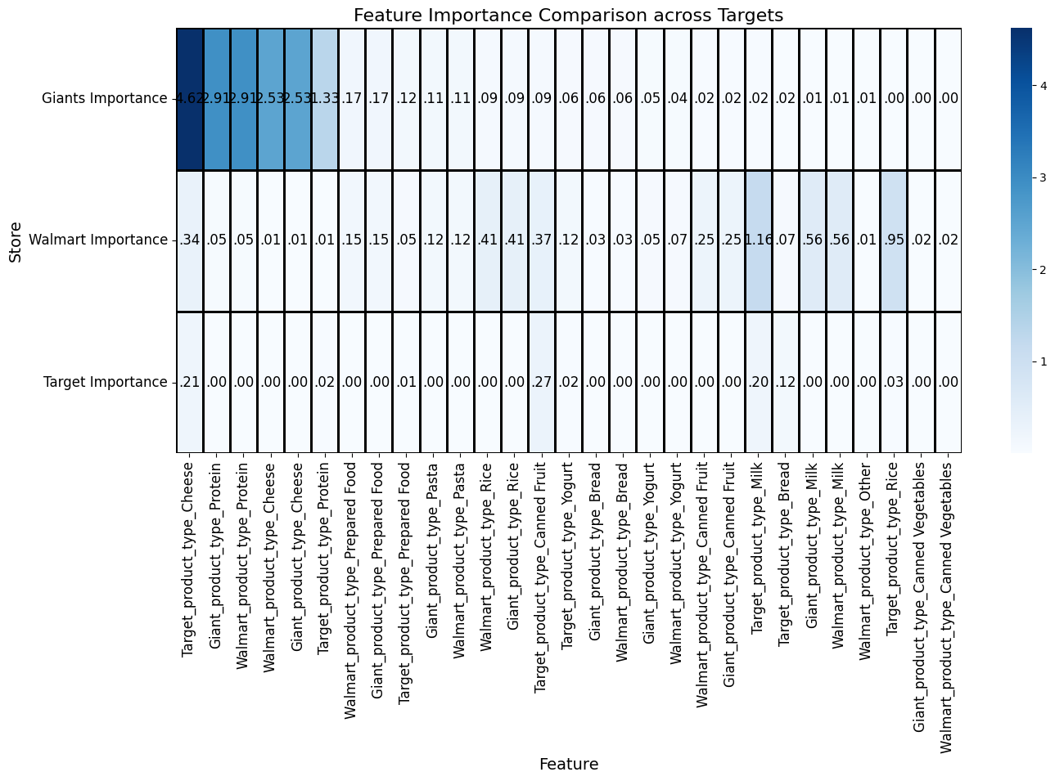
Notes:
Giant
Cheese and Protein are by far the most important features (importance scores > 4), indicating that these categories strongly affect Giant's pricing strategy.
Giant's pricing model is heavily skewed toward a few high-priced categories, especially Cheese and Protein — consistent with your earlier charts.
Walmart
Walmart’s model is more evenly distributed, with multiple moderate-scoring features:
Rice (0.41), Fruit (0.37), and Milk (0.56) are especially influential.
This suggests Walmart’s pricing is less influenced by luxury categories and more by staple or essential goods.
Target
Feature importances are very low overall, the highest being Yogurt (0.27) and Milk (0.20).
This implies that Target has more consistent pricing across product types, possibly due to centralized pricing, fewer extreme price ranges, or emphasis on house brands.

Slide 11
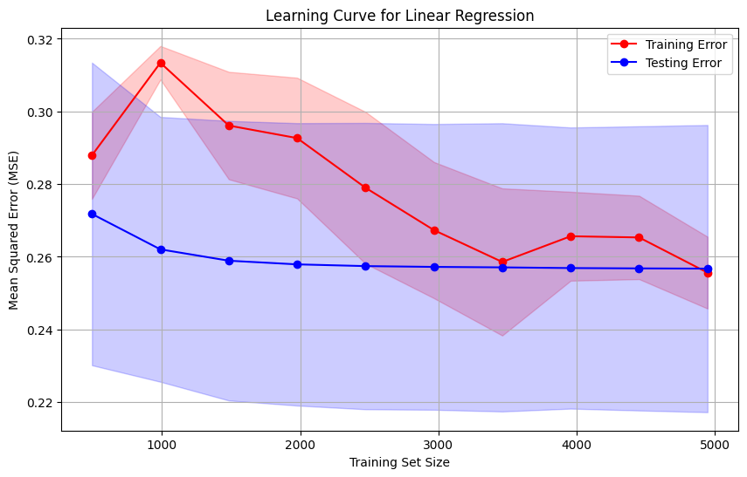
Notes:
Training Error (Red Line):
Starts high, then increases slightly (peaks around 1000), and gradually decreases as training size increases.
Suggests that as more data is fed into the model, the model fits the training data better, reducing error.
Testing Error (Blue Line):
Remains relatively flat and low, consistently around ~0.26 MSE.
Indicates good generalization performance — the model doesn’t overfit as the training data increases.
The linear regression model is not overfitting or underfitting — it generalizes well.
Increasing training data improves performance slightly, but gains plateau after ~3000 samples.

Slide 12
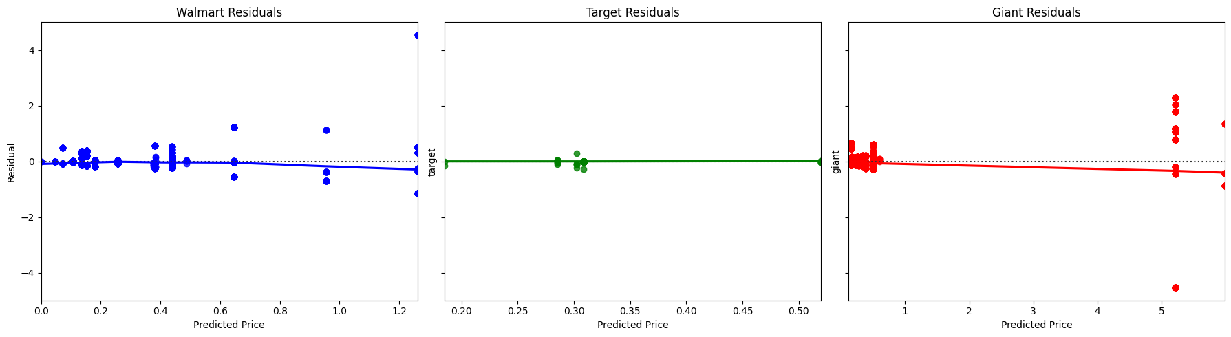
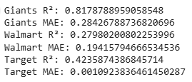
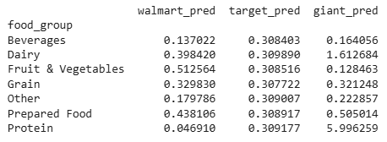

Slide 13
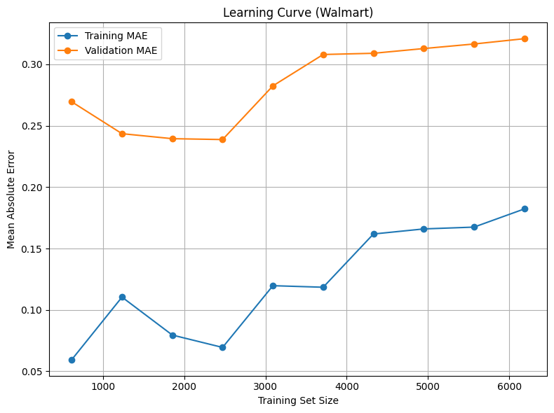
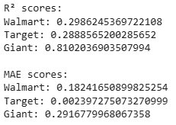
Hist Gradient Boosting Regressor
Notes:
overfitting

Slide 14
Future Direction
Dataset related:
Collect more data!
Expand to beauty, household, personal care, etc.
Expand bulk purchases (like Costco, Sam's Club, Bjs)
Larger geographic scope (CA vs. PA)
Modeling related:
Tune Multi-LR model
For predictions, generate a * size of product estimate = more applicable for shoppers (us!)
Try Light GBM
Handle missing values effectively
Bigger datasets

Slide 15
Implications to stakeholders
Customers: Informed purchasing decision & transparency
Retailers: Pricing strategy (competitor, geography)
Investors and Shareholders: Market insight; risk assessment
Policymakers: Regulate pricing (to a degree)
Economists and Academics: Consumer behavior research

Slide 16
Ethical, Legal, Social Concerns
Ensure fair comparisons (same product size/type)
Present findings objectively to avoid consumer panic
Respect website Terms of Service when scraping data
Consider how findings may affect retailer reputations
Avoid implying unfair pricing without strong evidence

Slide 17
Thank you

